Slide 1
STrace
A DTrace on Windows Reimplementation
By Stephen Eckels
Senior Reverse Engineer - FLARE

Slide 2




Stephen Eckels
Senior Reverse Engineer (FLARE)
Malware RE
R&D - RE tooling
Experience
Open-source development w/ a focus on hooking
x86/x64 ASM, C++, Rust, Go, JS, C#, Java, more ☺
System architect, embedded device software developer
Interests
Slacklining
Electric Mountainboarding
Gaming
@stevemk14ebr
github.com/stevemk14ebr/

Slide 3
Presentation Outline
What is DTrace? Why is it interesting Usage of Microsofts’ Port Shortcomings | DTrace on Windows Internals Modern dtrace architecture How kernel registration works Documenting kernel interfaces Inserting ourselves into the boot process Accessing paged out memory safely | STrace – Steve’s Tracer Differences to Microsoft’s port Writing a driver in Rust Adding WASM to the kernel Ditching rust drivers for C++ Loading DLLs in drivers DIY kernel -> user callstack trace DIY callstack symbolication

Slide 4
DTrace Introduction
What it is | Examples
Sun Microsystems -> Oracle -> OpenDTrace (2016) Tracing system allowing users to register probes Probes ‘fire’ on specific, user defined conditions Multiple types of probes are supported, each offering a different source of information STP – syscalls hooks FBT – kernel function boundary tracing PID – user function boundary tracing ETW – event tracing for windows (ETW) events When fired, probes execute user scripts in a VM inside the kernel
Print created files for a target process
syscall::NtCreateFile:entry
/ pid == $target && arg0 != 0 && arg2 !=0 /
{
attr = (OBJECT_ATTRIBUTES*)copyin(arg2, sizeof(OBJECT_ATTRIBUTES));
objectName = (UNICODE_STRING*)copyin(attr->ObjectName, sizeof(UNICODE_STRING));
name = *((ustr*)copyin((uintptr_t)objectName->Buffer, objectName->Length);
printf(“OBJECT_NAME: %ws”, name);
ustack();
}
Live system dump on specific error code
syscall:::return {
if (arg0 != 0xc0000001UL) {
lkd(0);
printf(\" Triggering Live dump \n \");
exit(0);
}
}

Slide 5
Advanced DTrace Examples
The pain begins…
Deferring Reads
syscall::NtCreateFile:entry {
// data behind pointer may be paged out. Don’t read until paged in.
self->pFileHandle = args[0];
}
syscall::NtCreateFile:return {
// system routine has paged in the memory.
if(arg0 == STATUS_SUCCESS) {
handle = *(HANDLE*)copyin(self->pFileHandle, sizeof(HANDLE));
printf("%08X", handle);
}
}
Pretty print enum types.
syscall::NtCreateFile:entry
/ pid == $target && arg0 != 0 && arg2 !=0 /
{
this->access = "|";
this->access = strjoin(this->access, (arg1 & FILE_READ_DATA) ? "ReadData|": "" );
this->access = strjoin(this->access, (arg1 & FILE_WRITE_DATA) ? "WriteData|": "" );
this->access = strjoin(this->access, (arg1 & FILE_APPEND_DATA) ? "AppendData|": "" );
this->access = strjoin(this->access, (arg1 & FILE_READ_EA) ? "ReadEa|": "" );
this->access = strjoin(this->access, (arg1 & FILE_WRITE_EA) ? "WriteEa|": "" );
this->access = strjoin(this->access, (arg1 & FILE_EXECUTE) ? "Execute|": "" );
this->access = strjoin(this->access, (arg1 & FILE_DELETE_CHILD) ? "DeleteChild|": "" );
this->access = strjoin(this->access, (arg1 & FILE_READ_ATTRIBUTES) ? "ReadAttributes|": "" );
this->access = strjoin(this->access, (arg1 & FILE_WRITE_ATTRIBUTES) ? "WriteAttributes|": "" );
printf(“CreateFile::ACCESS_MASK: %s”, this->access);
}

Slide 6
Advanced DTrace Examples
The pain begins…
Copying UNICODE_STRINGS, C preprocessor for ‘functions’
// DTCompile.bat
// @echo off
// start /wait cmd /c "cl.exe /P %1 && dtrace -s %~dpn1.i -c %2" & del %~dpn1.i
// Use: DTCompile.bat createfile.d %windir%/system32/notepad.exe
syscall::NtCreateFile:entry
/ pid == $target && arg0 != 0 && arg2 !=0 /
{
copy_ustr(arg2, fname, fnamelen);
printf("%*ws", fmt_ustr(fname, fnamelen));
}
#define copy_ustr(argname, varname, lenname) \
attr = (OBJECT_ATTRIBUTES*)copyin(argname, sizeof(OBJECT_ATTRIBUTES)); \
if(attr) { \
objectName = (UNICODE_STRING*)copyin((uintptr_t)attr->ObjectName, sizeof(UNICODE_STRING)); \
if (objectName) { \
this->##varname = (struct ustr*)copyin((uintptr_t)objectName->Buffer, sizeof(struct ustr)); \
this->##lenname = objectName->Length; \
}\
}
#define fmt_ustr(varname, lenname) (this->lenname / 2), this->varname->buffer

Slide 7
DTrace shortcomings
D language Issues
No user defined functions!
No loops!
Control flow structures like ifs occasionally compile to invalid instruction sequences in some cases
System design issues
Extremely limited side-effects. DTrace APIs like system only accept static strings
Issues accessing memory before syscalls execute
Features like the dtrace pre-processor are simply not implemented in Microsofts’ port
Wide string support is shaky at best. No string utilities are provided at all.
Developer experience tools lacking entirely, no IDE, syntax highlighting, etc.

Slide 8
DTrace on Windows Internals
Part 2
The start of a re-implementation
High level architecture
Boot process
Neat dtrace kernel tricks
Documenting kernel interfaces
We can do better!
<403 – meme forbidden>

Slide 9
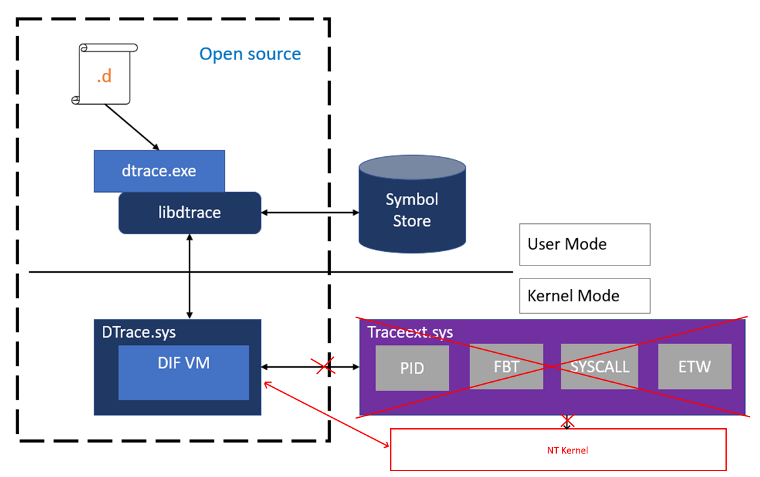
Architecture
The interface changed with 20H1! traceext.sys is no more
dtrace.sys registers a set of function pointers with the kernel for each probe type
dtrace.sys executes D language scripts in a VM and collects logs and tracing data
dtrace.exe communicates with dtrace.sys to fetch queued tracing data and provides cached symbol information to the driver.

Slide 10

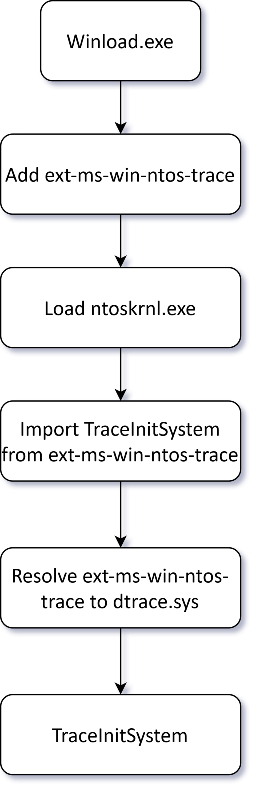


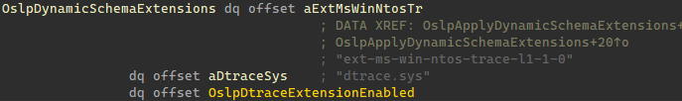
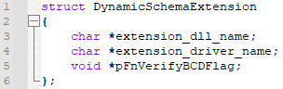



DTrace Boot
The boot process starts at the bootloader winload.exe
Check boot flag dtrace is on (bcdedit)
Add ext-ms-win-ntos-trace-l1-1-0.dll to schema set map
winload.exe begins to load ntoskrnl.exe
ntoskrnl.exe imports from this apiset, consulting the schema set map
ntoskrnl.exe calls TraceInitSystem from dtrace.sys
Invoked during phase 1 kernel initialization, before patchguard
KeInitSystem -> KiInitDynamicTraceSupport -> TraceInitSystem

Slide 11
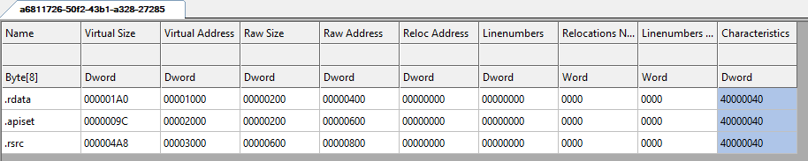
ApiSet Dlls
‘Pseudo’ PEs that contain a binary map pointing to implementing PEs
HKEY_LOCAL_MACHINE\SYSTEM\CurrentControlSet\Control\Session Manager\ApiSetSchemaExtensions\<anything>
FileName=<path_to_api_set.dll>
Name=<anything>

Slide 12
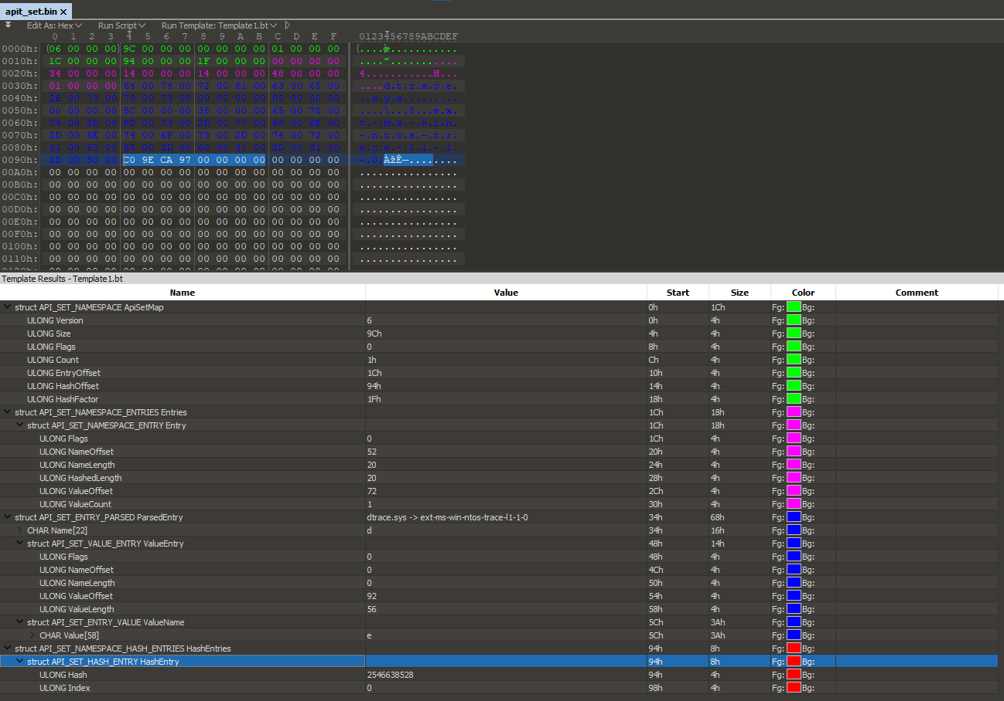
ApiSet Dlls
ApiSetExtensions are flipped
Host -> ApiSet

Slide 13
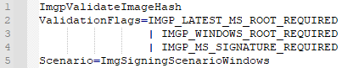
Signing Requirements
dtrace.sys is loaded as an import of ntoskrnl.exe
Despite being a dynamic extension, it’s considered ‘part of’ the kernel
Must be signed with an MS root code signing cert
schema set DLL must also be MS signed
So…how do we load our reimplementation of dtrace.sys?
We can re-use the MS signed schema set DLL to enable the dynamic schema set extension
Create new boot entry to disable DSE so that ntoskrnl.exe can load our unsigned driver as an import
Signing it yourself, test signing, custom kernel signers, etc…will NOT work.
Microsoft: Please reconsider this design and allow dtrace.sys to be signed by non-MS parties.

Slide 14
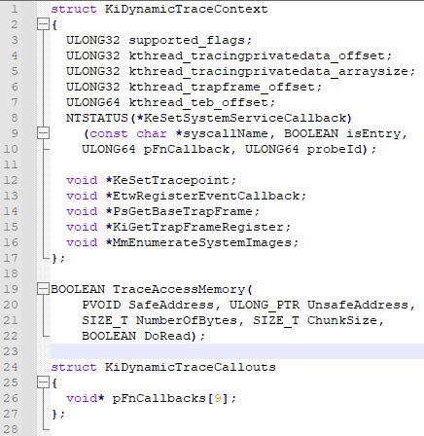
DTrace Kernel Registration
TraceInitSystem
dtrace.sys fills KiDynamicTraceCallouts table to
handle each probes’ events
dtrace.sys passes a pointer to
TraceAccessMemory to ntoskrnl.exe
ntoskrnl.exe records the start and end bounds of
this routine via the x64 unwind table entry
ntoskrnl.exe passes a pointer to
KiDynamicTraceContext to dtrace.sys
Provides offsets into kernel structures for the
current kernel version
Provides APIs to set and remove trace probes

Slide 15
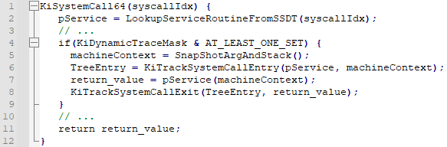
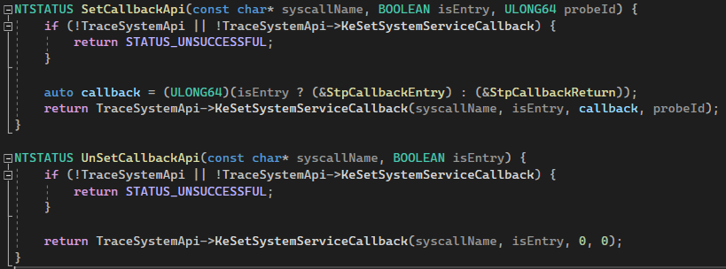
Syscall Probes!
KiSystemCall64
Fires for all usermode syscalls
And Zw* calls, as they go through KiServiceInternal
Nt* calls are not traced.
Shadow SSDT syscalls not supported
KiTrackSystemCallEntry -> StpCallbackEntry
KiTrackSystemCallExit -> StpCallbackReturn
Probe entry / exit callbacks must be one of the two Stp
functions set in KiDynamicTraceCallouts during TraceInitSystem
KiDynamicTraceCallouts is PG protected.

Slide 16
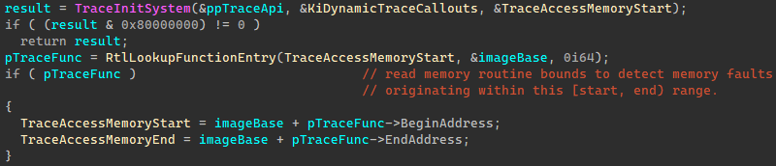
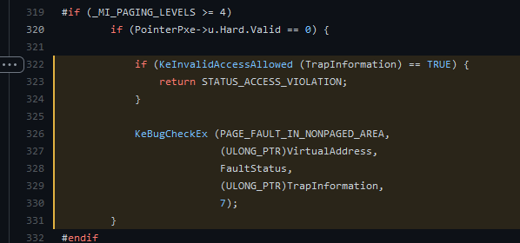
DTrace Tricks
TraceAccessMemory – safely read arbitrary inaccessible or paged out memory at a high IRQL w/o blue screening
copyin in DTrace scripts use this
MmAccessFault -> KeInvalidAccessAllowed
Why?

Slide 17
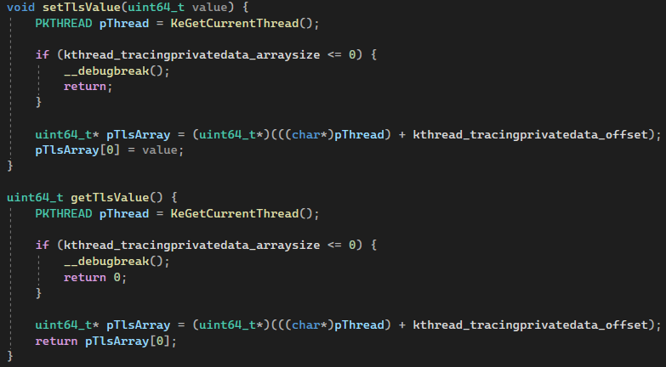
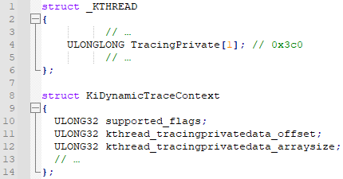
DTrace Tricks
self keyword– kernel thread local storage
Used by dtrace to cache D language intermediate data, such as thread local data

Slide 18
DTrace Tricks
dtrace_action_lkd – live kernel dumps
lkd in DTrace scripts use this
void DbgWerCaptureLiveKernelDump(wchar_t* ComponentName,
ULONG BugCheckCode,
ULONG P1, ULONG P2, ULONG P3, ULONGP4,
ULONG flags);
Generates standard .dmp files loadable in windbg
NtSystemDebugControl
Flags and registry settings to control this API now officially documented!
https://docs.microsoft.com/en-us/windows-hardware/drivers/devtest/dtrace-live-dump
Generated dumps typically in C:\Windows\LiveKernelReports

Slide 19
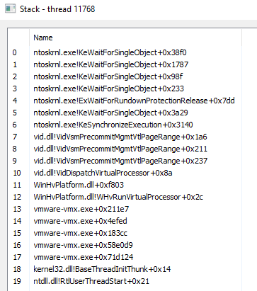
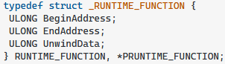
DTrace Tricks
ProcMon
TraceWalkUserStack – Generate a symbolic stack trace down to usermode.
ustack() in dtrace
Operates differently from how ‘other’ tools generate stack traces
Usermode API: StackWalk64 + DIA symbol APIs
Small trick to start at kernel, grab Ethread.Kthread.KernelStack.RSP
Trace initiated from usermode, drivers can’t call this
TraceWalkUserStack does what StackWalk64 does, manually
Trace initiated from kernelmode
RtlCaptureStackBackTrace doesn’t include usermode calls
How?
Given some starting address, locate the module’s
DataDirectory[IMAGE_DIRECTORY_ENTRY_EXCEPTION]
unwind data defines a series of opcodes to ‘undo’ the effects of a function on the CPU state.
These are ‘virtually’ executed, then the return address from the unwound stack is read, and the process repeats
Ex: UWOP_PUSH_NONVOL – a register pushed to stack, RSP += 8 to undo
Latest Call
Stack Walk
Kernel
UserMode
“How to Unwind”
Oldest Call

Slide 20
STrace
Part 3
Writing a re-implementation!
Differences to Microsoft’s port
Writing a driver in Rust
Adding WASM to the kernel
Ditching rust drivers for C++
Loading DLLs in drivers
DIY callstack symbolication
Who says hipster languages don’t belong in the kernel??

Slide 21
STrace vs. DTrace
dtrace executes at IRQL == 15, STrace doesn’t touch IRQL – usually LOW_LEVEL
Memory accesses simpler
Enables wide range of APIs to be called in handlers
Plugins can perform arbitrary side-effects and may call any kernel APIs
Plugins are written in modern C++, rather then D Language
Faster than interpreting too!
Symbolication of output occurs after logging, rather than within the driver.
For simplicity
Only syscalls probe types are supported, FBT, PID, ETW, etc are not supported
Partially due to DSE being off, hypervisor features like FBT can’t be implemented
Open to PRs for ETW!
Zw* Apis can be monitored, dtrace filters these out.

Slide 22
System Architecture Choices
Requirements
Must execute scripts provided from usermode somehow
Must be fast enough to be called every syscall
The script language must be pleasant and familiar to all users
Must execute in the kernel – zero dependencies
Nice to haves
Users shouldn’t need kernel development experience to use
Users should be able to call into the kernel for side-effects
Symbolic call stacks
The Journey of STrace’s design
Rust w/ WASM scripts
C++ w/ WASM scrips
C++ w/ C++ scripts
C++ w/ C++ scripts & Rust symbolication

Slide 23
WASM in the NT Kernel!
Just bad enough of an idea it’s great
dtrace uses a VM for execution, it tries to be isolated. Can we do that somehow?
Web technologies already solved this
We can compile any language to WASM!
Wasm toolchains are somewhat mature, but they all mostly focus on javascript being your build target.
Blockchain technologies solved this
Enter WASMI – Parity Ethereum contracts are in WASM
Wasmer doesn’t support no_std ☹
Not many good embedded WASM interpreters!
Deep call stacks, exhausting the kernel stack. KeExpandKernelStackAndCalloutEx ☹
Massive local buffers??
Too slow
Need a JIT, no hackable low dependency WASM JITs

Slide 24
Rust in the NT Kernel!
Rust and the DDK together make an unpleasant experience
Microsoft only officially supports C
Complicated .cargo/config build profile needed to invoke VS linker properly
Complicated build.rs script needed
Rust doesn’t properly (easily?) generate free standing binaries
Unwind tables aren’t reliably generated
Symbols like __CxxFrameHandler3, __chkstk, etc, must be stubbed – always generated ☹
Handful of I.C.E.’s
Microsoft doesn’t provide Rust API projections for the kernel
Every single API, type, and define must be manually ported to rust ☹
Rust doesn’t support anonymous unions and structures; Windows uses this extensively ☹
Rust’s no_std story is, complicated
Many libraries don’t support no_std
Providing allocator mappings isn’t exactly easy
At the time of writing, std::ffi:CString wasn’t even supported in Rust no_std. This has since changed.
UNSAFE EVERYWHERE!

Slide 25
C++ > Rust
Rust and WASM was painful
C++ wins
API and structures definitions known correct
Toolchain supported officially
Can C++ host our WASM scripts instead?
Yea, but it’s hard, no zero dependency C++ WASM interpreters – wasted weeks trying
Deadend.
How else can we provide users the ability to ‘script’
Execute blobs of code as shellcode??
Position Independent compiler: https://github.com/SheLLVM/SheLLVM
Little too hacky…

Slide 26
C++ DLLs in the NT Kernel
Windows has a mechanism for shipping blobs of dynamic code – DLLs!
Not at all supported in the kernel
Manual DLL mappers aren’t that hard to write
Kernel isn’t wildly different to usermode really
Remove all dependencies like the CRT, exceptions, disable stack checks and other security mechanisms
Re-use DLL IAT and EAT for kernel APIs
Compiler is a bit too smart with intrinsics
It works! And it’s fast! And Easy!
Toolchain is normal too!
// mycrt.h
extern "C" char* strcpy(char* a, const char* b);
#pragma intrinsic(strcpy)
// mycrt.cpp
#pragma function(strcpy)
extern "C" char* strcpy(char* a, const char* b)
{
char* saved = a;
while (*a++ = *b++);
return saved;
}

Slide 27
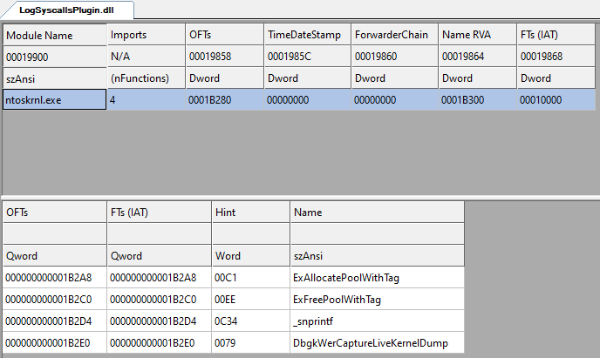
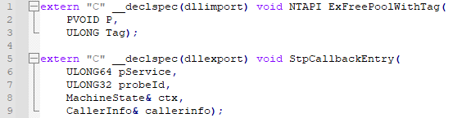
DLLs importing kernel APIs
DLL imports are resolved via .lib files
DDK injects kernel .lib files into the msvc linker path
Not available when not writing drivers
Workaround - manually link a copy of ntoskrnl.lib

Slide 28
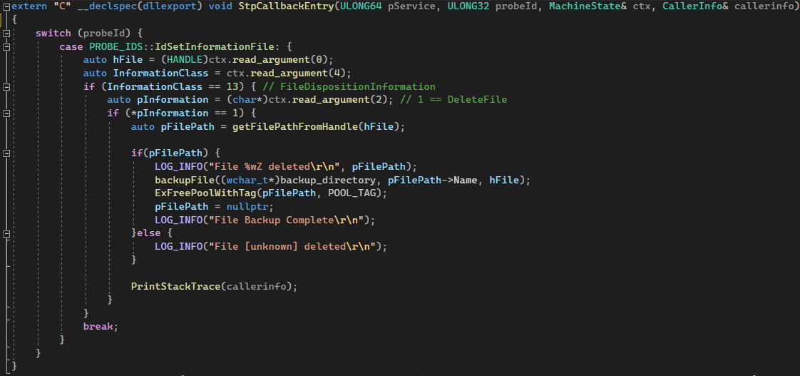
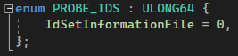
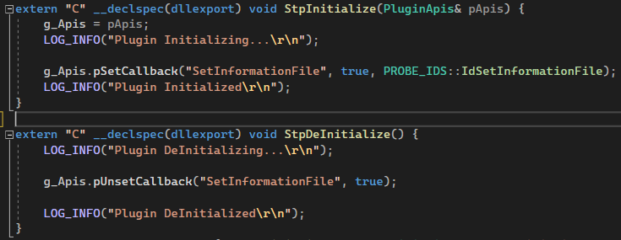
An STrace plugin DLL
Define probe ID map
Set and Unset probes
Handle Callbacks!

Slide 29
DIY Callstack Symbolication
Grab callstack via RtlWalkFrameChain + RTL_WALK_USER_MODE_STACK
Walks unwind codes just like dtrace does
Resolve callstack addresses to modules + offsets
Fetch and parse PDBs – Introducing PDBReSym!
Read module PDB filename, guid, age from debug directory data
Fetch PDB from http://msdl.microsoft.com/download/symbols/<pdb_filename>/<pdb_guid+pdb_age>/<pdb_filename>
Cache same as WinDbg does
Parse PDB
Build PC line to nearest symbol RangeMap cache (binary tree).
Use PC line to symbol cache to resolve module name and offset pairs to symbols
Re-write log lines with demangled symbolic line
NO DIA SDK USAGE!

Slide 30
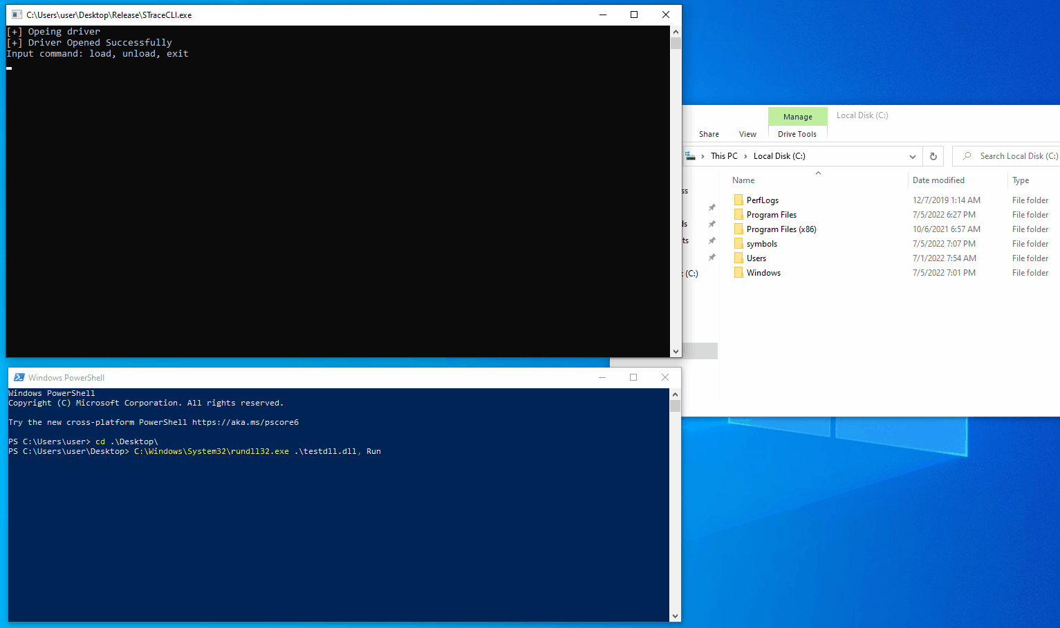
Demo!

Slide 31
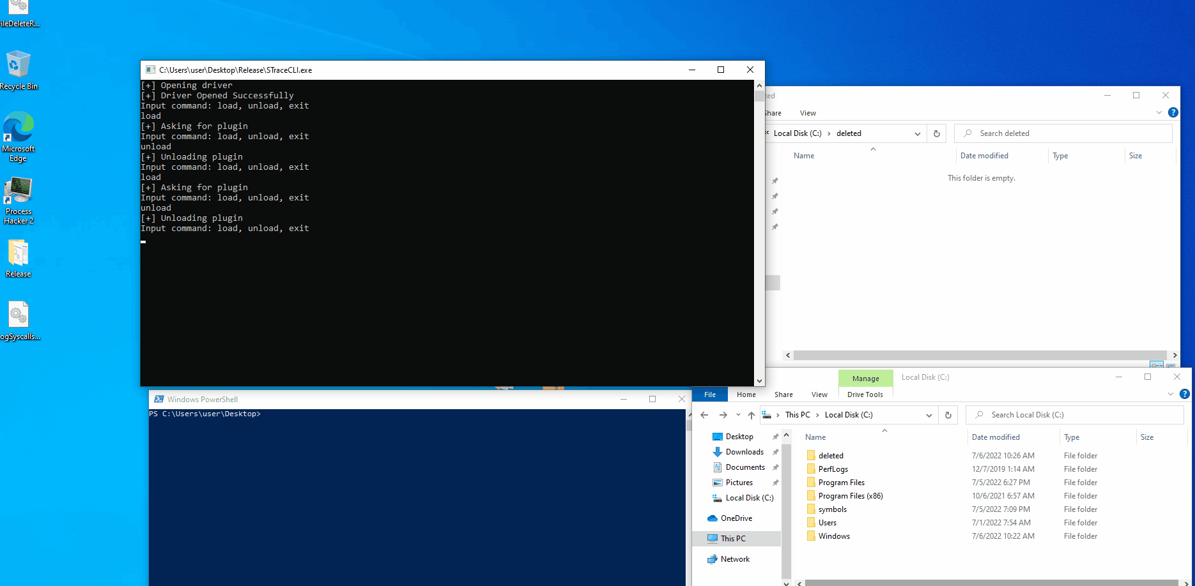

Slide 32
Thank You.

